Slide 1
Web Systems and Algorithms
Unit 6
Combining Classifiers

Slide 2
Combining Classifiers
One must neither tie a ship to a single anchor, nor life to a single hope

Slide 3
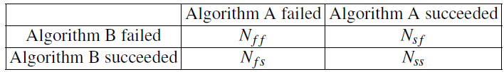
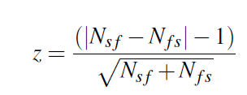
Model Comparison
A
cat-plant
fish-animal
rose-plant
B
cat-animal
fish-animal
rose-plant
Nff=0
Nsf=0
Nfs=1
Nss=2
McNemar’s test
Compare the two classifier
Based on the following contingency table
Compute
If z = 0, the two algorithms are said to show similar performance

Slide 4
Model Comparison…
Example
Algorithm A
Cat → Plant (Wrong Classification)
Tiger → Animal (Right Classification)
Rose → Plant (Right Classification)
Algorithm B
Cat → Animal (Right Classification)
Tiger → Animal (Right Classification)
Rose → Plant (Right Classification)
Here
Nff = 0, Nsf = 0, Nfs = 1, Nss = 2
Z= (|Nsf - Nfs| - 1) / (Sqrt(Nsf+Nfs)) = 0
i.e. Both algorithm have similar performance

Slide 5
Ensemble Technique
Combining multiple techniques
Two techniques
Bagging (Bootstrap aggregation)
Boosting

Slide 6
End of Session

